Slide 1
Space Complexity
March 3,2023
Christo Shaji
Metatitans

Slide 2
Introduction
•Space complexity is nothing but the amount of memory space that an algorithm or a problem takes during the execution of that particular problem/algorithm.
•Auxiliary space is the space required by an algorithm/problem during the execution of that algorithm/problem and it is not equal to the space complexity because space complexity includes space for input values along with it also.
•Space Complexity = Auxiliary Space + Space used for input values
•Space complexity of an algorithm is commonly expressed using Big O (O(n)) notation.

Slide 3
Need To Calculate Space Complexity
Calculation and analyzing of this space complexity is important because in real world applications developers are bounded/limited to acquire the memory in the devices.
If an algorithm takes up a lot of time, you can still wait, run/execute it to get the desired output. But, if a program takes up a lot of memory space, the compiler will not let you run it.
An algorithm is sufficient when the algorithm is solving the problem in less amount of time while taking the least amount of space.

Slide 4
Types of space complexities:
1. Constant Space Complexity: If the amount of memory used by the algorithm is independent of the input size. For example, an algorithm that sorts an array in place has a constant space complexity of O(1).
2. Linear Space Complexity: If the amount of memory used by the algorithm is proportional to the input size. For example, an algorithm that creates an array of n elements has a linear space complexity of O(n).
3. Quadratic Space Complexity: If the amount of memory used by the algorithm is proportional to the square of the input size. For example, an algorithm that creates a two-dimensional array of size n x n has a quadratic space complexity of O(n^2).
4. Exponential Space Complexity: If the amount of memory used by the algorithm grows exponentially with the input size. For example, an algorithm that generates all subsets of a set of n elements has an exponential space complexity of O(2^n).

Slide 5
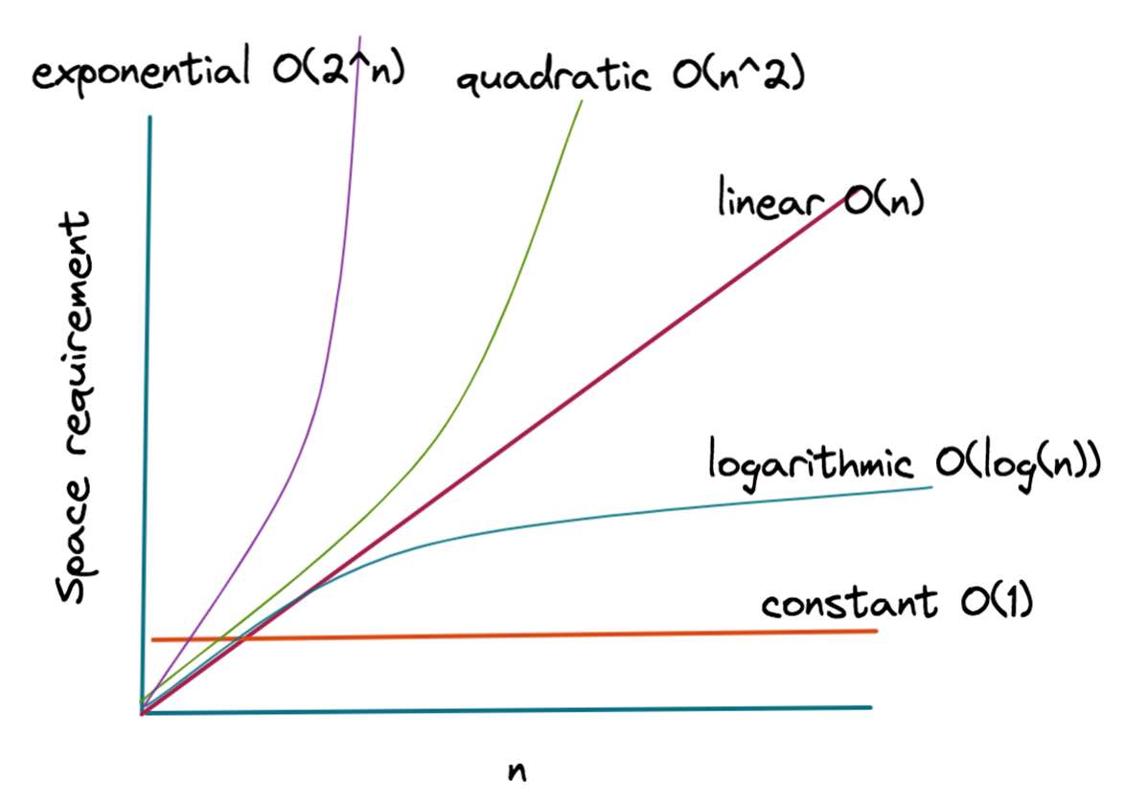
Graphical representation of various space complexities

Slide 6
How To Evaluate Space Complexity
•Identify the variables and data structures used by the algorithm
•Determine the space requirements of each variable and data structure
•Count the number of times each variable or data structure is used
•Sum up the space requirements of all variables and data structures:
•Finally, express the space complexity as a function of the input size.
•This is usually done using big O notation, which gives an upper bound on the space requirements of the algorithm as the input size grows.

Slide 7
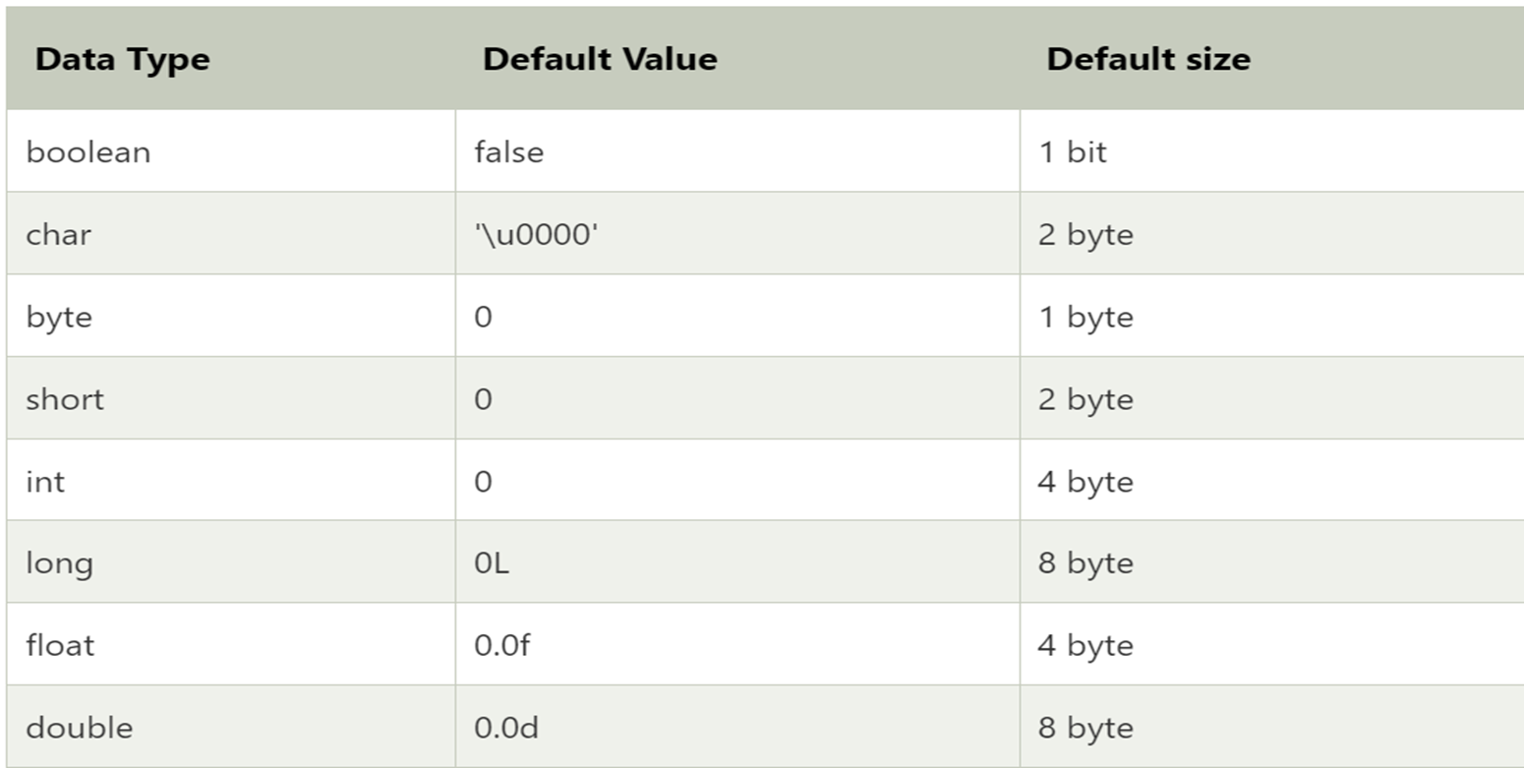
The following chart shows the default size of various data types used in java

Slide 8
Example 1: Factorial of a Number(Iterative)
"fact" is an integer variable which will store the factorial of the number(N), as a variable fact will take the "4 bytes" of space.
"N" is an integer variable which stores the value for which we have to find the factorial, so no matter what value will, it will just take "4 bytes" of space.
"i" is an iterator variable which stores the current value of iteration, so it will also take "4 bytes" of space.
Now function call, initializing for loop and return function these all comes under the auxiliary space and lets assume these all will take combinedly “4 bytes” of space.
Hence, Total Space Complexity = 4*4=16 bytes
As there is no variable which just constant value(16) is there so it means that this algorithm will take constant space that is "O(1)".
factorial(N){
int fact=1;
for (int i=1; i<=N; i++)
{
fact*=i;
}
return fact;
}

Slide 9
Example 2: Factorial of a number(Recursive)
Now,"N" is an integer variable which stores the value for which we have to find the factorial, so no matter what value will, it will just take "4 bytes" of space.
Now function call, "if" condition, "else" condition, and return function these all comes under the auxiliary space and lets assume these all will take combinedly “4 bytes” of space.
But the matter of fact here is that here we are calling that function recursively "N" times so here the complexity of auxiliary space will be "4*N bytes" where N is the number of which factorial have to be found.
Hence, Total Space Complexity = (4 + 4*N) bytes But these 4 bytes are constant so we will not consider it and after removing all the constants(4 from 4*N) we can finally say that this algo have a complexity of "O(N)".
factorial(N){
if(N<=1)
{
return 1;
}
else
{
return (N*factorial(N-1));
}
}

Slide 10
Conclusion
Creators of real-world programs are constrained by the physical memory of the platforms they plan to run on. That's where space complexity comes into play, as its obvious that we never ever want to run a function or process that consumes more space than the system has available at any one time.
Helps to find to out the most optimized algorithm among all the algorithms, for particular type of problem.
The best algorithm/program should have the least space-complexity. The lesser the space used, the faster it executes.
After completing your program always analyze the worst-case scenario so that it can handle the large inputs and can have high adaptability and supportability.

